Slide 1
Advanced Encryption
Squad
Xinlin Chen Zhonghan Li Nnenna Nwagbo

Slide 2
Advanced Encryption Standard
128-bit block Rijndael ciphers
Selected by NIST in 2001 out of 15 competing designs
AES-128: key-space of 2¹²⁸, or 3.4 x 10³⁸
1019 years to cover space at 1 Tera-keys/second
Notes:
Used by US government to protect information up to the SECRET level
Robust against brute-force attacks

Slide 3
Advanced Encryption Standard
10 cycles of transformation rounds b/w plain- and ciphertext
SubBytes
ShiftRows
MixColumns
AddRoundKey
Motivation: digital communications, privacy
Overall goal: performing AES-128 encryption on an FPGA board
Notes:
Chat messaging, email, file encryption

Slide 4
Project Delegation
John: Designing components, development, testbench writing, Main coder, debugging, presentations
Janet: Designing components, researching AES-128 encryption steps and running through algorithm with team, debugging, testbench writing, report writing, presentations
Nnenna: Designing components, development, researching FPGA messaging possibilities, board implementation, input/outputs, debugging, report writing, presentations

Slide 5
System architecture
CPUs: Nios II
IO: Keyboard, LCD Screen.
Peripherals: Keyboard.
Logic: AES-128 Hardware Implementation
Notes:
Architecture (implementation strategy, optimizations used, input/output requirements, etc)

Slide 6
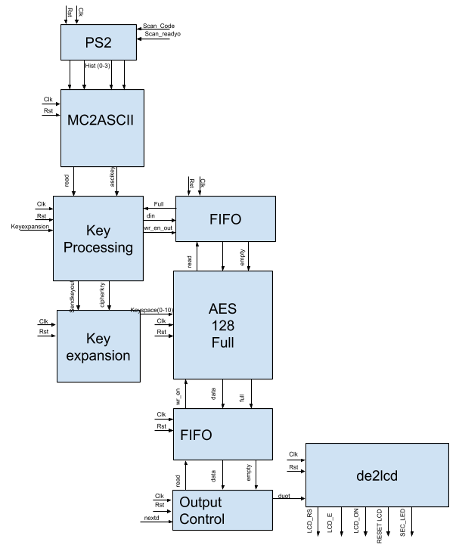
Block Diagram

Slide 7
From keyboard input to key/message
PS2 - takes keystrokes and converts them to “make”/”break” code
“f” pressed down - “2B” “2B” “2B” etc. is output
“f” released - “F0 2B” is output
MC2ASCII - make, break codes → ASCII characters
KeyProcessing - ASCII characters → key or message

Slide 8

Constructing the key/message

Slide 9
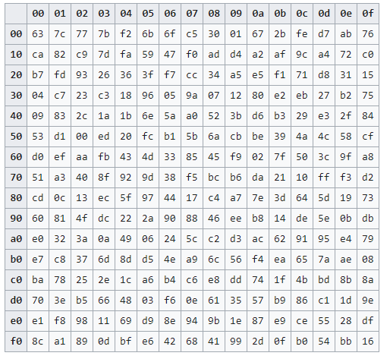
Roundkey Generation
Convert 128-bit cipher key into 16 easy to manage bytes
Process last word(Circular left shift, byte substitution, round constant addition)
New word is generated(w4 = w0 xor P(w3), w5= w4 xor w1, w6 = w5 xor w2, w7 = w6 xor w3)
Implemented using an FSM
https://kavaliro.com/wp-content/uploads/2014/03/AES.pdf

Slide 10
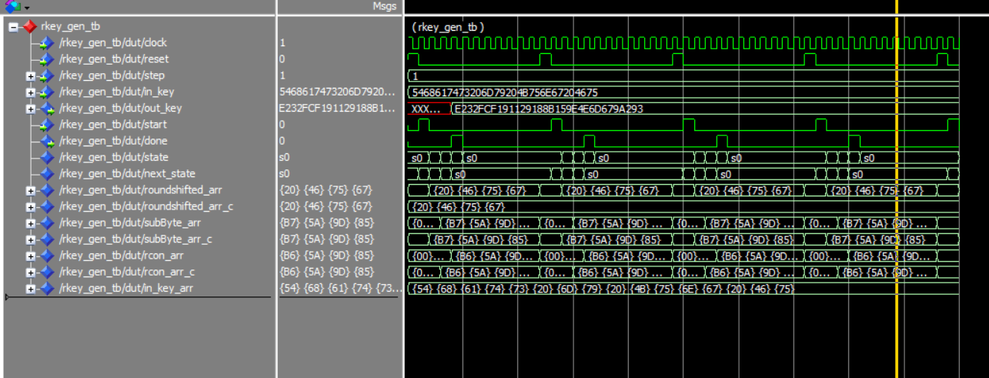
Roundkey Generation Step

Slide 11
KeyExpansion
Performs 10 roundkey generating steps in sequence
Output is original cipher key + 10 roundkeys

Slide 12
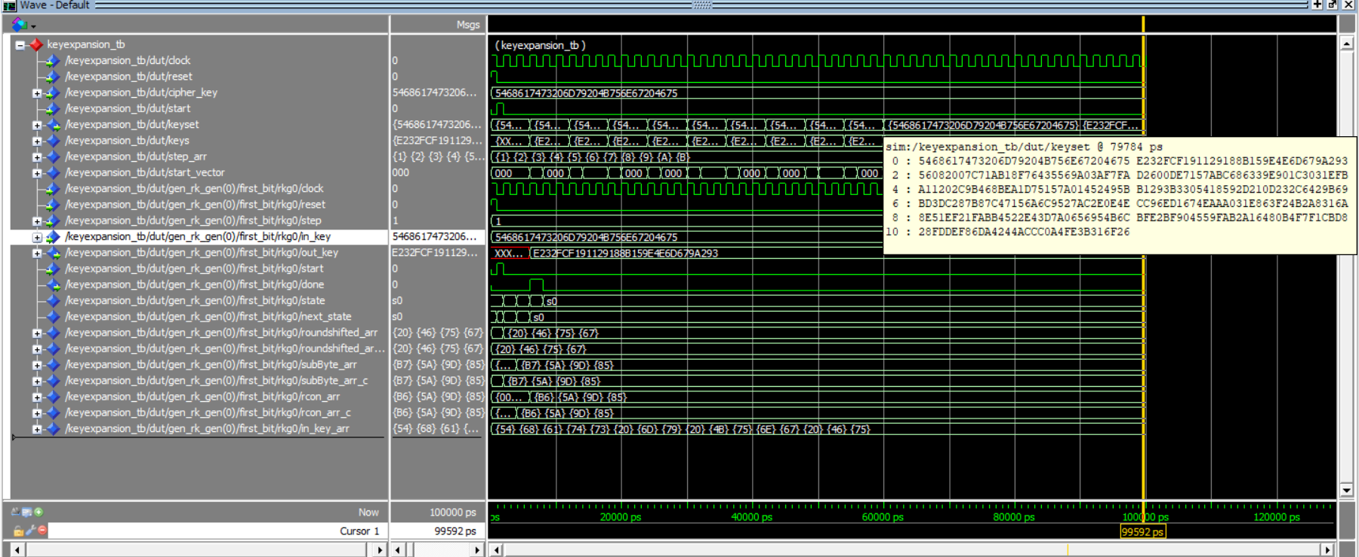
KeyExpansion

Slide 13
AES 128 Step
4 Steps:
SubBytes
ShiftRows
MixColumns
AddRoundKey

Slide 14
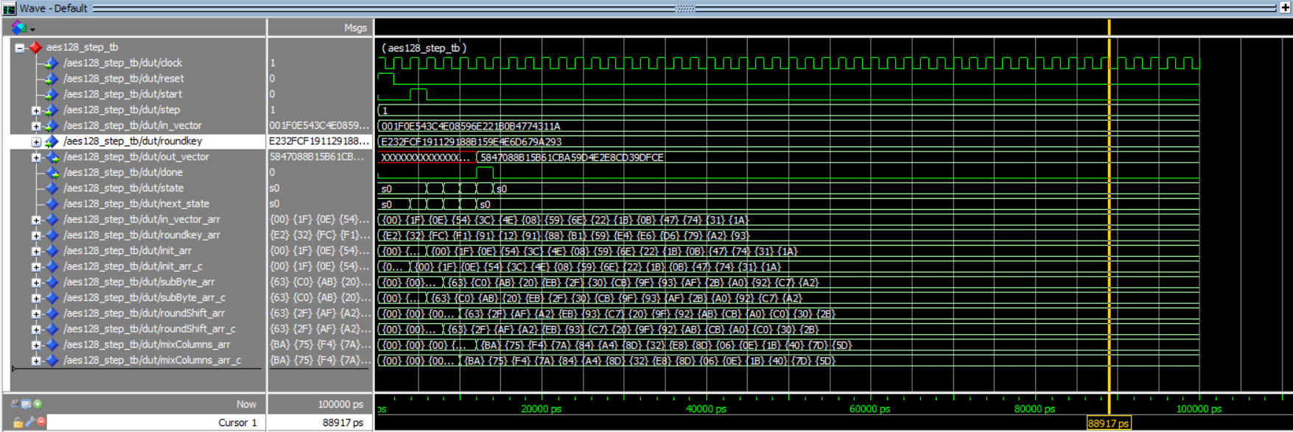
AES128 Step

Slide 15
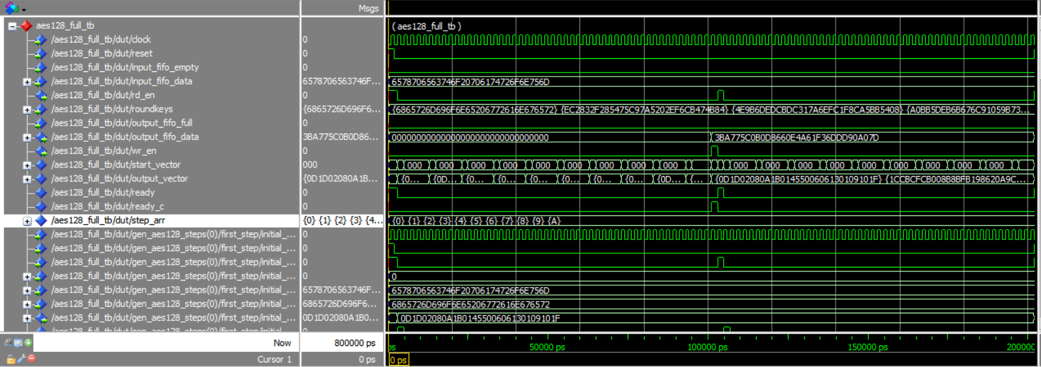
AES128 Full

Slide 16
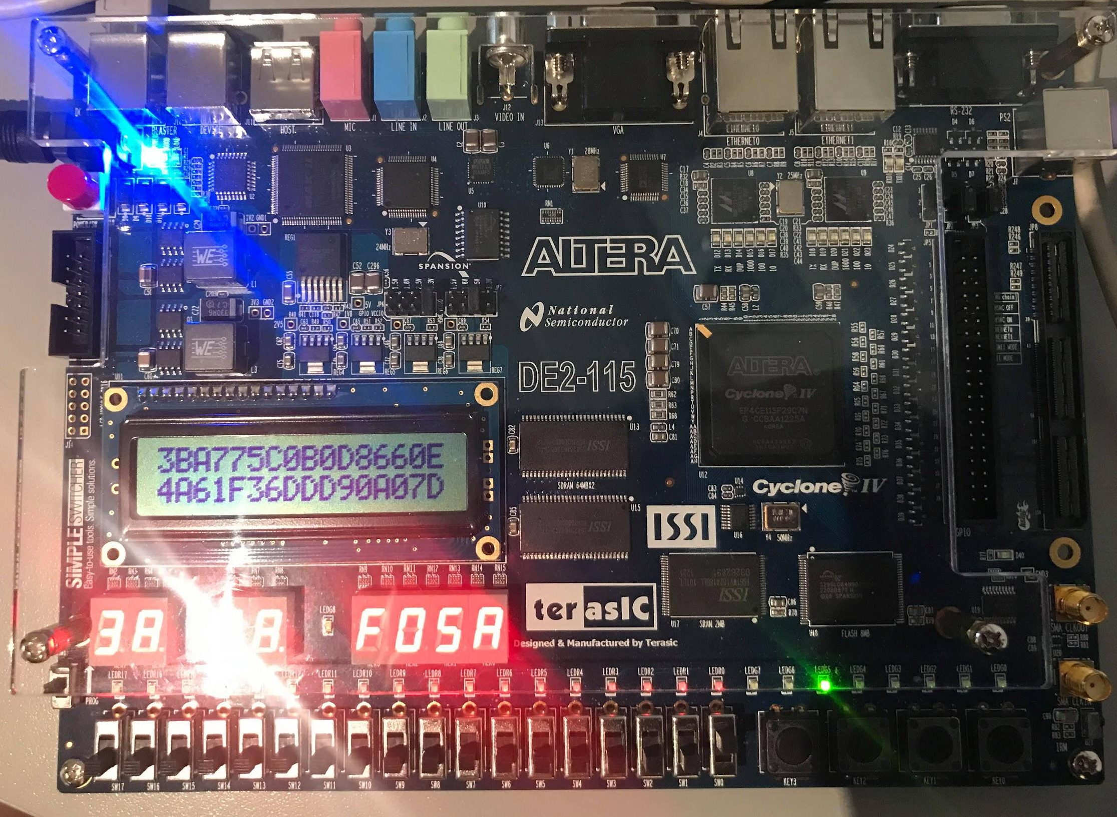
Working Output Display
Key: hermione granger
Plaintext: expecto patronum
Ciphertext: 3B A7 75 C0 B0 D8 66 0E 4A 61 F3 6D D 90 A0 7D
When decrypted with online tools: expecto patronum

Slide 17
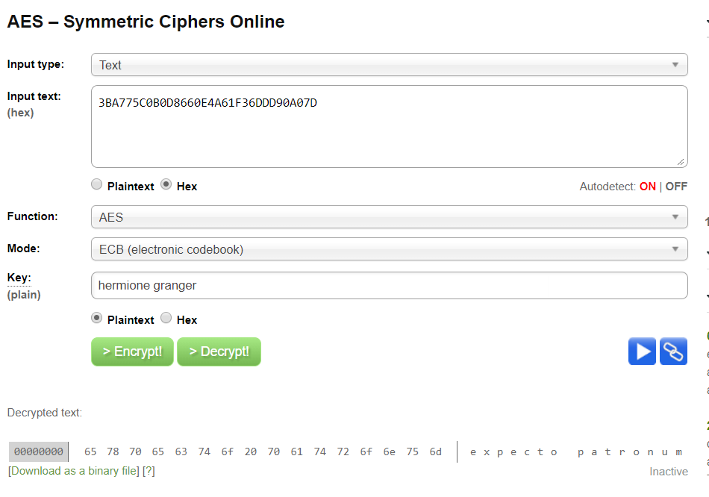
Decrypted Message
http://aes.online-domain-tools.com/

Slide 18
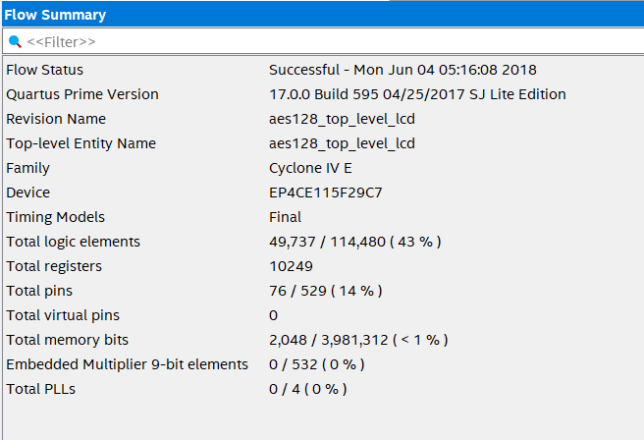
Synthesis Summary

Slide 19
Future steps
Enabling transmission of encrypted messages between different devices
AES-128 decryption
Working with other alphabets, non ASCII characters - e.g. the pound (currency) and the euro, ideograms
Pipelining
Hashing Cipher Key

Slide 20
Thank You
Questions?

